Slide 1
2022 Ideas

Slide 2
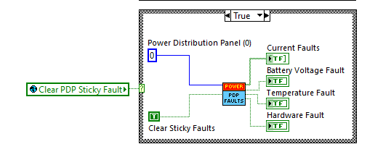
Clear PDP Sticky Faults in Teleop

Slide 3
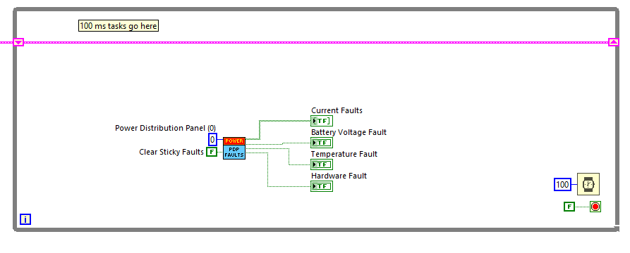
Clear PDP Sticky Faults in Periodic Task?

Slide 4
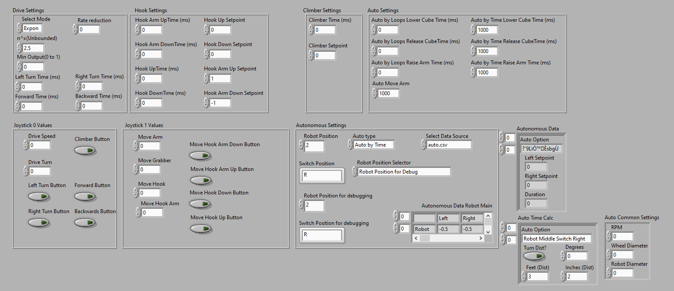
Robot Global Data

Slide 5
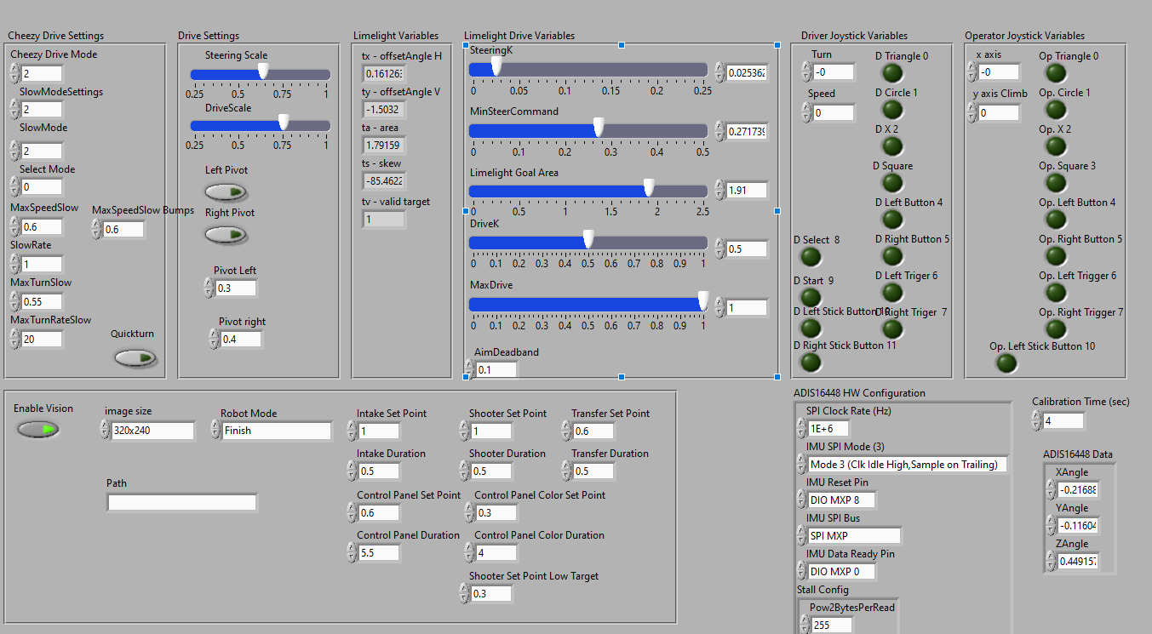
Robot Global Data

Slide 6
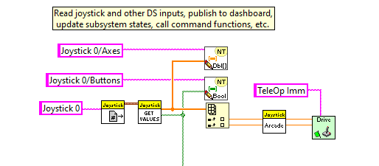
Read Joysticks

Slide 7
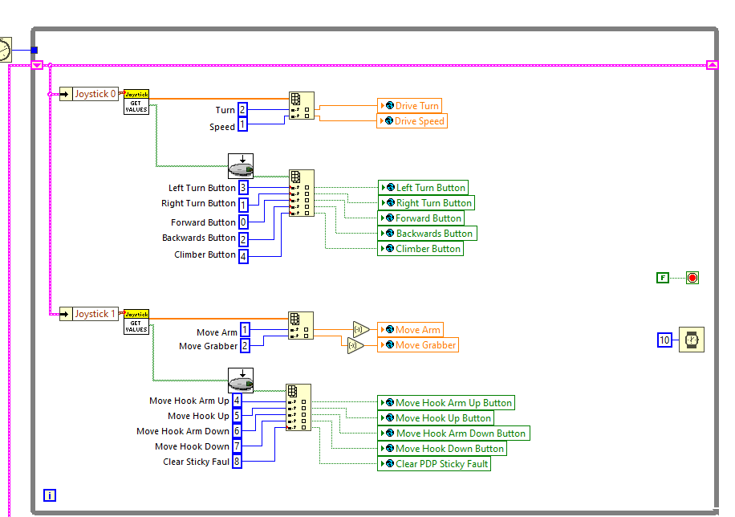
Read Joysticks

Slide 8
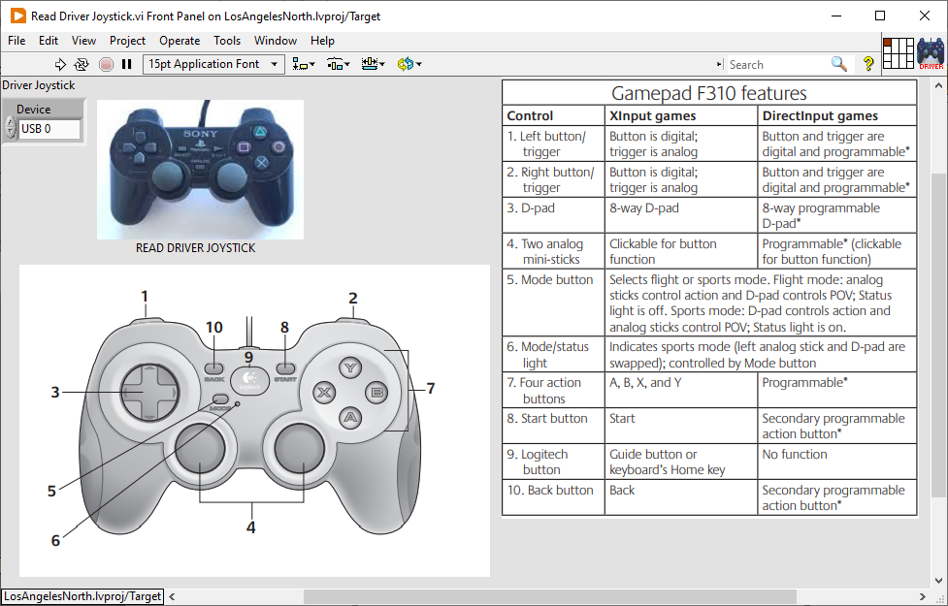
Read Joysticks

Slide 9
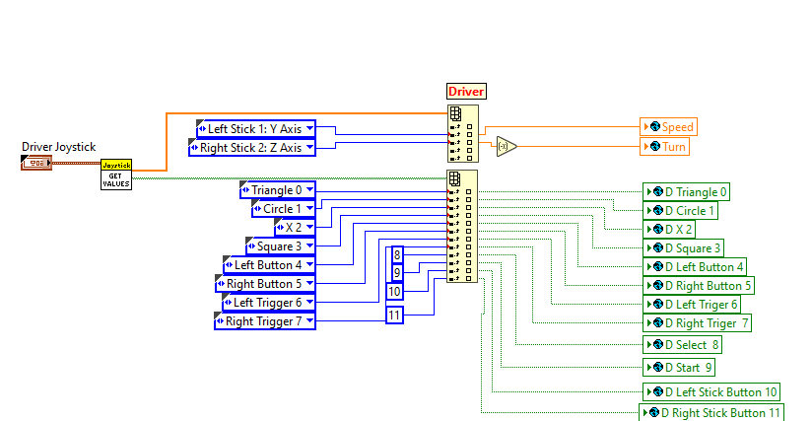
Read Joysticks

Slide 10
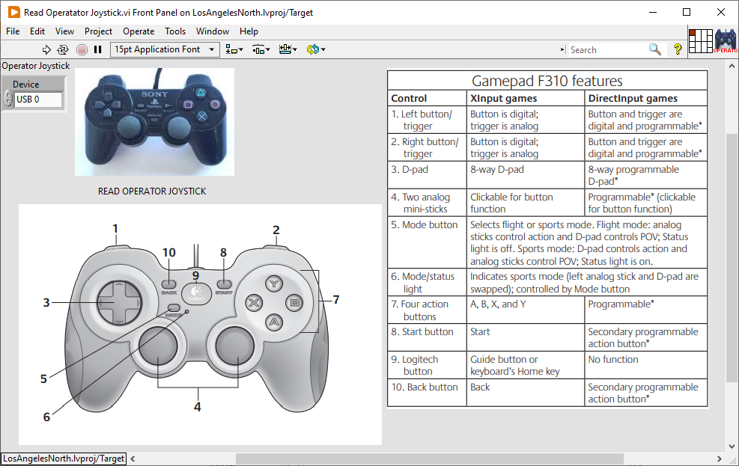
Read Joysticks

Slide 11
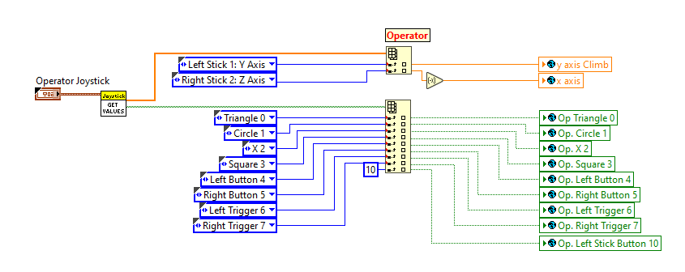
Read Joysticks

Slide 12
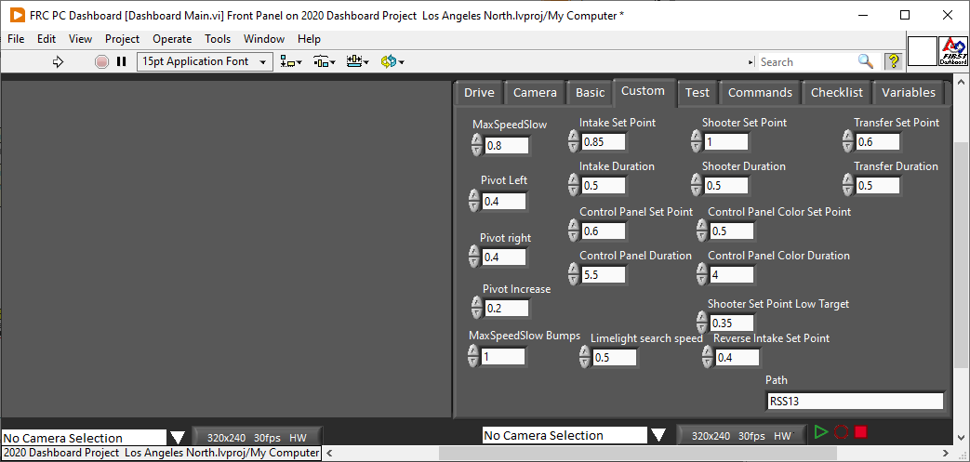
Add Dashboard Variables

Slide 13
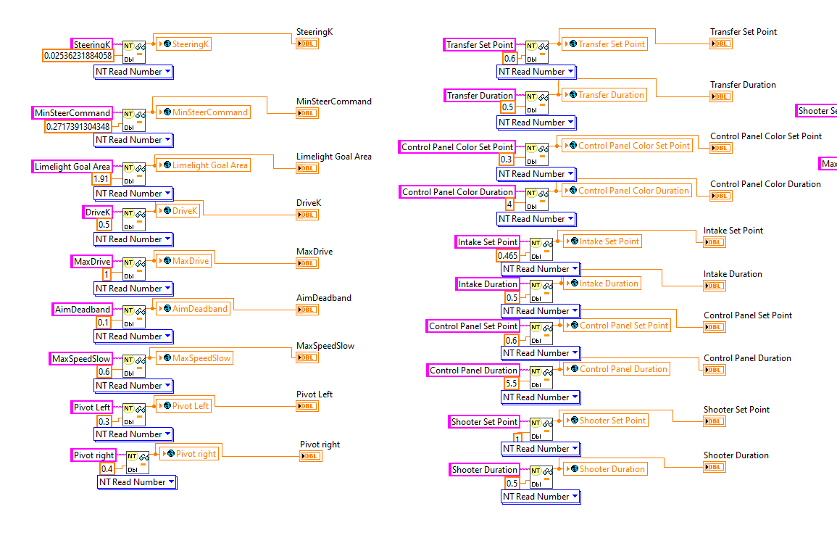
Read Dashboard Variables

Slide 14
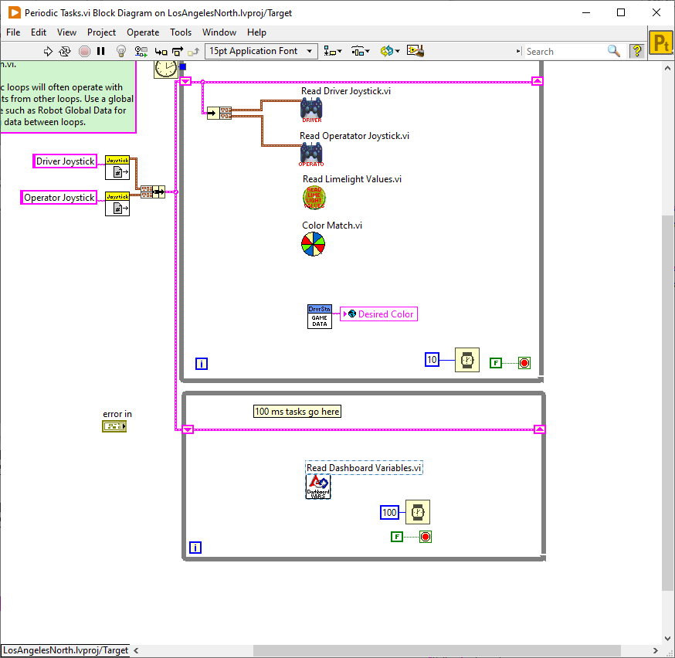
Read Dashboard Variables

Slide 15
Clear PDP Sticky Faults

